Slide 1


Customer Sentiment Analysis
Boat Smart watch
Product Link

Slide 2
Our deliverables to Brand
Sentiment-based binary classification model (positive/ negative) for customer product review on amazon (1186 review)
Helps us to improve the product features.
Sentiment prediction for new Reviews dataset (886reviews)

Slide 3
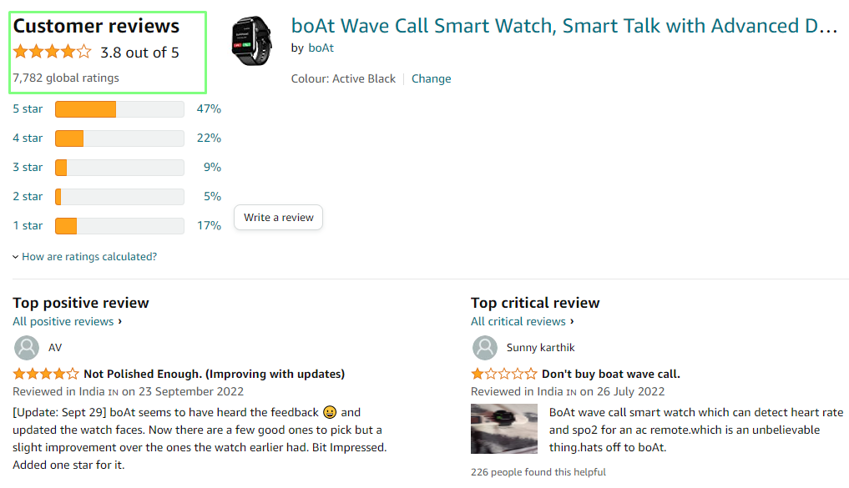
Data Collection
Reviews of the product has been collected from amazon platform by using python scrapping method and it is extracted into excel format (1186 review).

Slide 4
Model Approach
Assumption
All number & special characters dropped
Assumed all reviews are in English
Trained a classification Model
Predicting review as positive and negative comments
Using Random forest

Slide 5
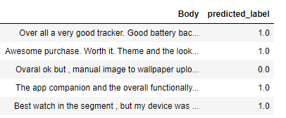


Predicted sentiment labels for New dataset
Model accuracy 75.5%

Slide 6
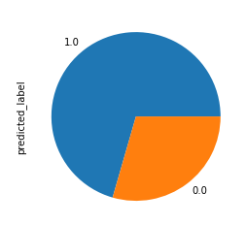
Insights: Most of the Customers are happy
Positive and Negative feed back
Positive Feedback (1) : 625
Negative Feedback(0): 261

Slide 7
Important Observation from Review Analysis
Most repeated complaint are mentioned below
Low Battery life
Issue with loading the media
Bluetooth connectivity problem

Slide 8
Thank You.
By:- Karthickraja Devadoss
karthickraja9868@gmail.com

